Slide 1
Loan Eligibility Model
LHL
Zara Faraz

Slide 2
Project Goal
Purpose of this study is to develop a model that will help the bank to automate the loan eligibility process for it’s customer.
The dataset contains random data of 614 individuals and 12 features. 1 column is the target data (Loan_Status: Yes/No)
Hypothesis
Applicant having a credit history more likely to secure a loan

Slide 3
Exploratory Analysis
Here are a few inferences, you can draw by looking at the output of df.describe() function:
LoanAmount has 22 missing values (614 – 592) .
Loan_Amount_Term has 14 missing values (614 – 600) .
Credit_History has 50 missing values (614 – 564).
We can also look that about 84% applicants have a credit_history.
The mean of Credit_History field is 0.84
OR 475/564
The ApplicantIncome distribution seems to be in line with expectation. Same with CoapplicantIncome

Slide 4
Exploratory Analysis
Here are a few inferences, you can draw by looking at the output of pd.value_counts(df.ColName) function:
We can see that approximately 81% are Male and 19% are female.
Percentage of applicants with no dependents is higher.
There are a greater number of graduates than non graduates.
Semi Urban people is slightly higher than Urban people among the applicants.
The percentage of people that the loan has been approved has been higher rather than the percentage of applicant for which the loan has been declined.

Slide 5
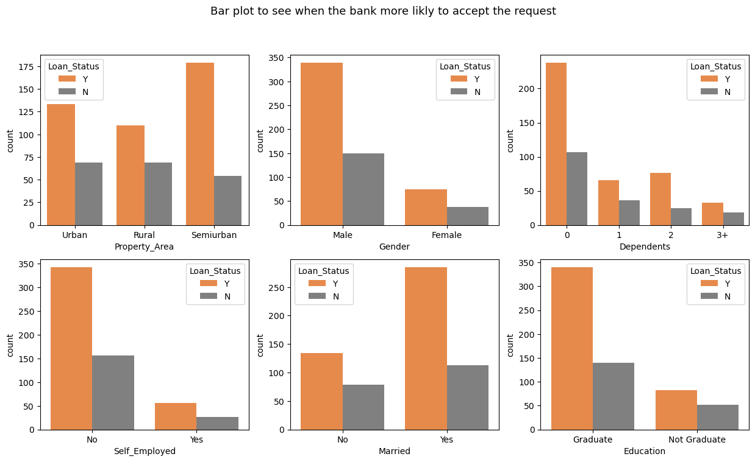
EDA

Slide 6
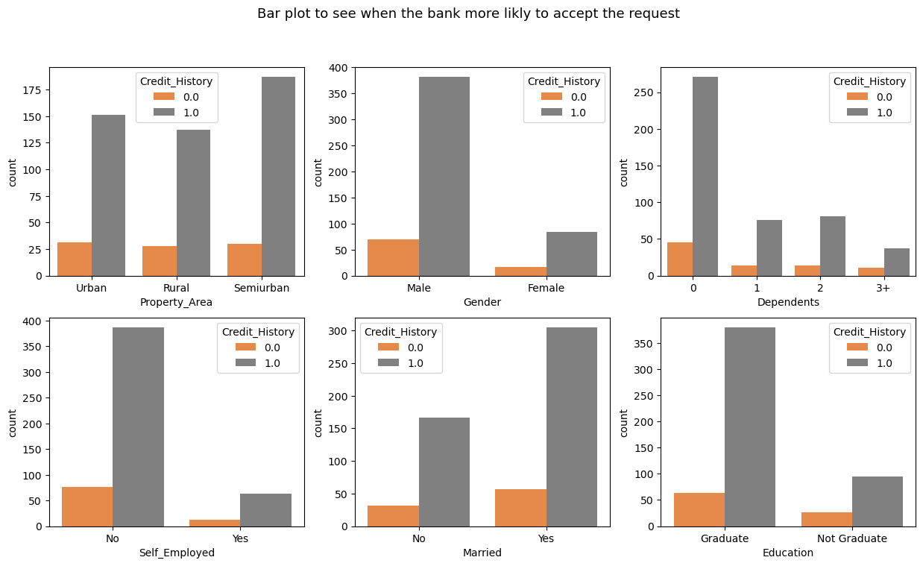
EDA

Slide 7
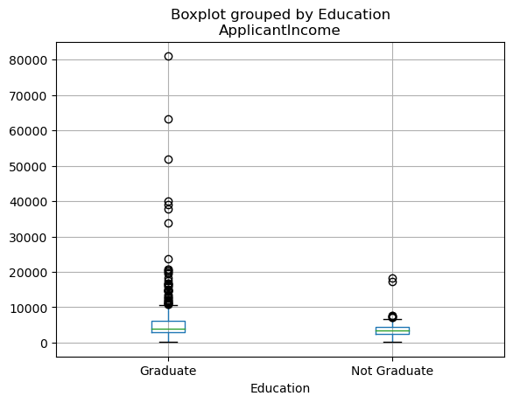
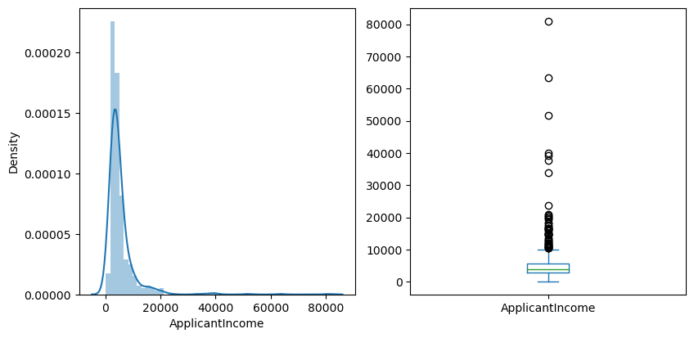
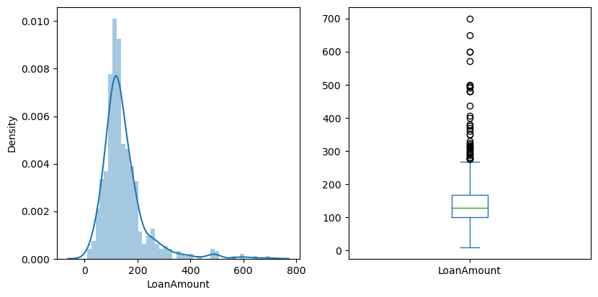
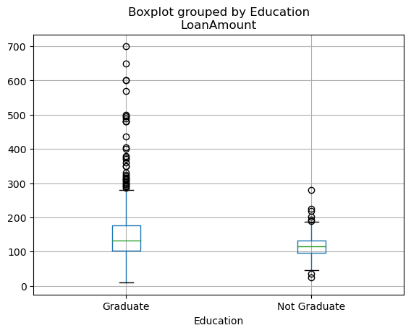
EDA
### Analysis
Here we observe that there are few extreme values. Next, we look at box plots to understand the distributions. This confirms the presence of a lot of outliers/extreme values. This can be attributed to the income disparity in the society. Part of this can be driven by the fact that we are looking at people with different education levels.
### Analysis
Here we observe that there are few extreme values. Next, we look at box plots to understand the distributions. This confirms the presence of a lot of outliers/extreme values. This means that some people have received a higher loan than usual. One of the reason might be that applicants that graduated were given a higher loan since they might have good jobs and means to return the loan. However, this still requires further analysis.

Slide 8
PIVOT TABLE for categorical variables with numeric
 | ApplicantIncome | CoapplicantIncome | Credit_History | LoanAmount
Loan_Status
N | 5446.078125 | 1877.807292 | 97.0 | 151.220994
Y | 5384.068720 | 1504.516398 | 378.0 | 144.294404
Gender
Female | 4643.473214 | 1108.008929 | 84.0 | 126.697248
Male | 5446.460123 | 1742.932352 | 382.0 | 149.265957
Married
No | 4970.384977 | 1316.558685 | 167.0 | 128.883495
Yes | 5629.173367 | 1794.632965 | 305.0 | 155.750000
Self_Employed
No | 5049.748000 | 1580.989840 | 387.0 | 141.748963
Yes | 7380.817073 | 1501.341463 | 63.0 | 172.000000
Education
Graduate | 5857.433333 | 1717.474833 | 380.0 | 154.060215
Not Graduate | 3777.283582 | 1276.544776 | 95.0 | 118.409449
### Analysis
There is not much difference between the mean income of applicant income who got the loan and those who did not.
Applicants that had there loan rejected had asked for a greater loan on average, which might be the reason for rejection.
On average, Male’s have a higher income and higher loan amount.
More married people have applied for the loan and for a lot of them the loan amount is high. This might be due to house or car loans that couple take out.
Self-employed individuals have a higher income and higher loan amount.
On average applicants that are graduate have a higher income.

Slide 9
 |  |  |  | ApplicantIncome | CoapplicantIncome | Credit_History | LoanAmount
Loan_Status | Gender | Married | Self_Employed | Education
N | Female | No | No | Graduate | 4201.473684 | 414.210526 | 10.0 | 118.000000
 |  |  |  | Not Graduate | 3139.000000 | 0.000000 | 2.0 | 85.333333
 |  |  | Yes | Graduate | 4874.666667 | 572.333333 | 2.0 | 142.000000
 |  |  |  | Not Graduate | 3867.000000 | 0.000000 | 1.0 | 62.000000
 |  | Yes | No | Graduate | 3504.400000 | 1554.400000 | 4.0 | 118.600000
 |  |  |  | Not Graduate | 2149.000000 | 3237.000000 | 0.0 | 178.000000
 |  |  | Yes | Graduate | 8500.000000 | 0.000000 | 0.0 | 195.500000
 | Male | No | No | Graduate | 5778.741935 | 2184.774194 | 18.0 | 154.633333
 |  |  |  | Not Graduate | 3438.555556 | 554.666667 | 6.0 | 94.500000
 |  |  | Yes | Graduate | 9681.600000 | 866.600000 | 3.0 | 137.600000
 |  |  |  | Not Graduate | 3411.000000 | 1984.000000 | 0.0 | 174.000000
 |  | Yes | No | Graduate | 7507.277778 | 2203.833333 | 28.0 | 186.039216
 |  |  |  | Not Graduate | 3603.620690 | 1575.724138 | 11.0 | 128.307692
 |  |  | Yes | Graduate | 5479.555556 | 3539.444444 | 4.0 | 177.125000
 |  |  |  | Not Graduate | 4517.750000 | 1296.250000 | 3.0 | 144.250000
Y | Female | No | No | Graduate | 4117.823529 | 718.823529 | 29.0 | 111.058824
 |  |  |  | Not Graduate | 2834.333333 | 394.166667 | 6.0 | 97.166667
 |  |  | Yes | Graduate | 7559.400000 | 0.000000 | 3.0 | 105.000000
 |  |  |  | Not Graduate | 17714.000000 | 0.000000 | 2.0 | 175.000000
 |  | Yes | No | Graduate | 4639.875000 | 1495.625000 | 14.0 | 143.125000
 |  |  |  | Not Graduate | 3015.000000 | 769.000000 | 1.0 | 108.666667
 |  |  | Yes | Graduate | 19484.000000 | 0.000000 | 1.0 | 600.000000
 |  |  |  | Not Graduate | 7142.000000 | 0.000000 | 1.0 | 138.000000
 | Male | No | No | Graduate | 4870.500000 | 1800.960000 | 48.0 | 127.437500
 |  |  |  | Not Graduate | 3706.062500 | 1159.250000 | 14.0 | 97.375000
 |  |  | Yes | Graduate | 8536.571429 | 0.000000 | 6.0 | 215.142857
 |  |  |  | Not Graduate | 4191.500000 | 1083.500000 | 2.0 | 118.000000
 |  | Yes | No | Graduate | 5170.633136 | 1756.478817 | 151.0 | 151.757576
 |  |  |  | Not Graduate | 3449.261905 | 1597.952381 | 36.0 | 122.950000
 |  |  | Yes | Graduate | 8085.379310 | 2021.793103 | 28.0 | 180.321429
 |  |  |  | Not Graduate | 4541.200000 | 808.200000 | 4.0 | 115.600000

Slide 10
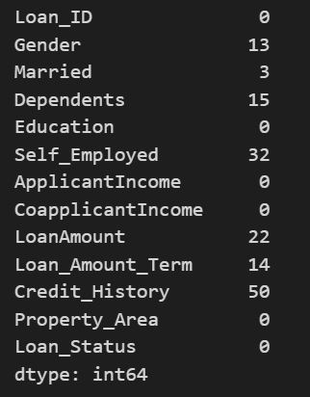
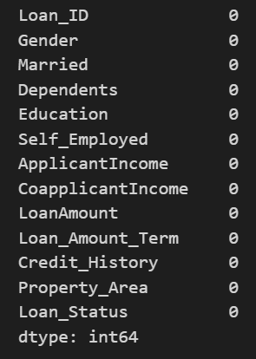
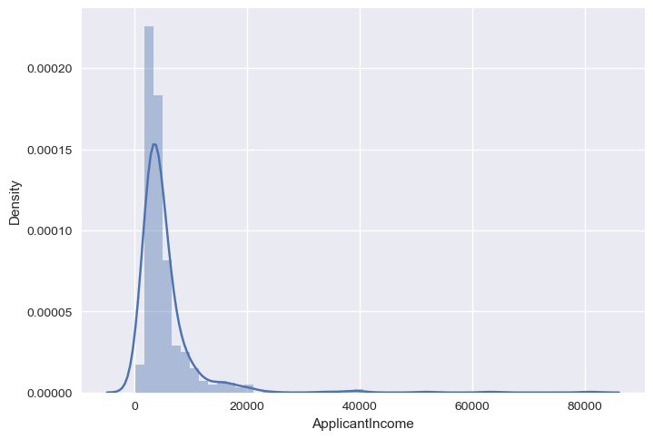
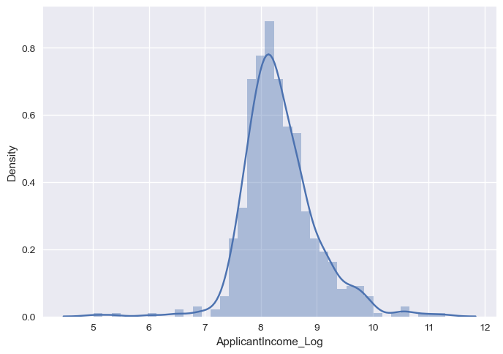
Process
Treating the null values
Log Transformation
Creating new column – Total Income
One hot coding for categorical columns
 | Before | After
Treating Null Values
Log Transformation (ApplicantIncome)

Slide 11
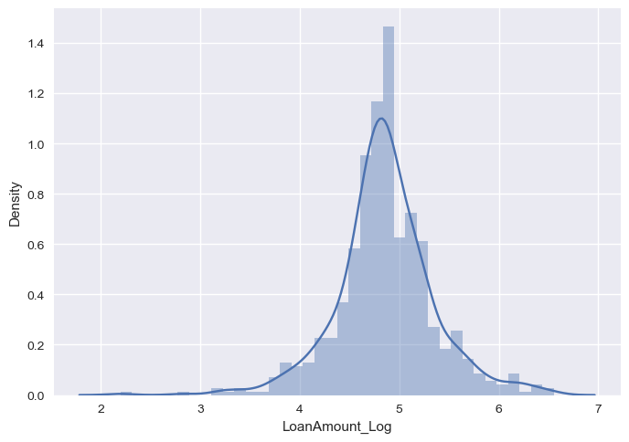
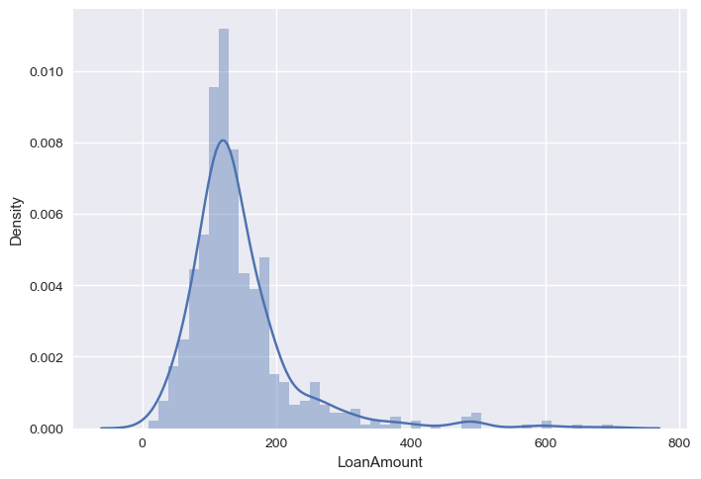
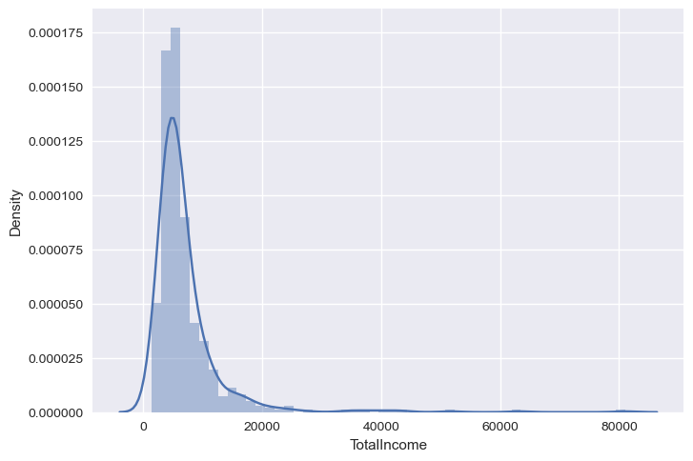
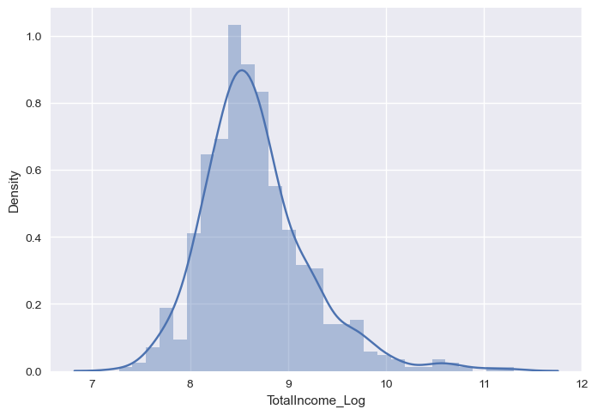
Process
Treating the null values
Log Transformation
Creating new column – Total Income
One hot coding for categorical columns
 | Before | After
Log Transformation (LoanAmount)
Created New Column |  | Total Income = Applicant Income + Co Applicant Income
Log Transformation (TotalIncome)

Slide 12
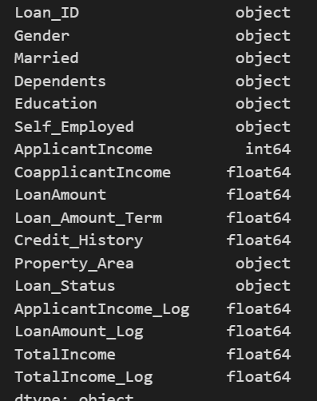
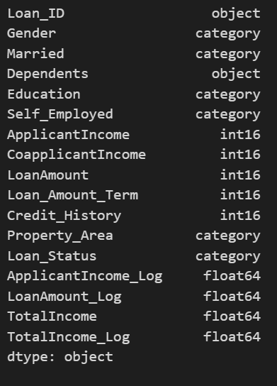
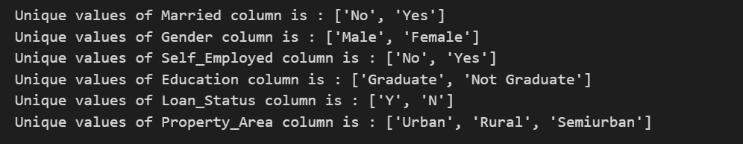
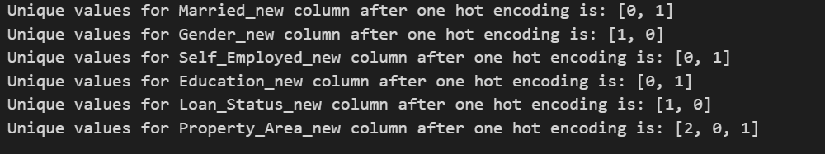
Treating the null values
Log Transformation
Creating new column – Total Income
One hot coding for categorical columns
 | Before | After
Dependents | 3+ | 3
as.type
One hot encoding
Drop column | Loan_ID

Slide 13
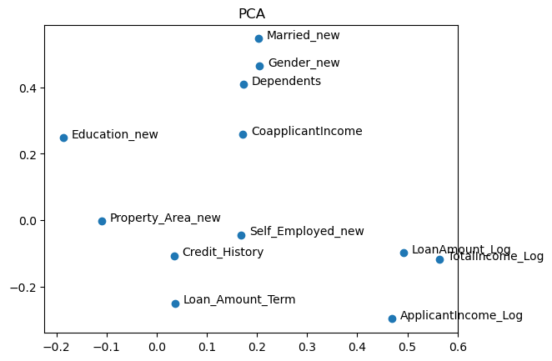
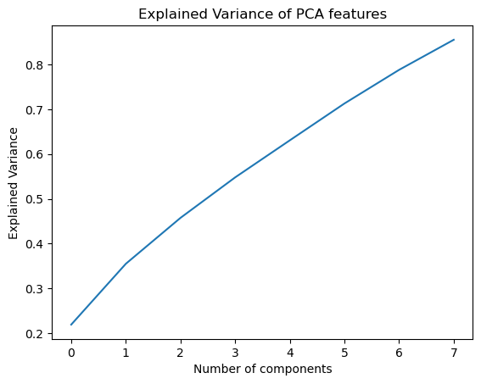
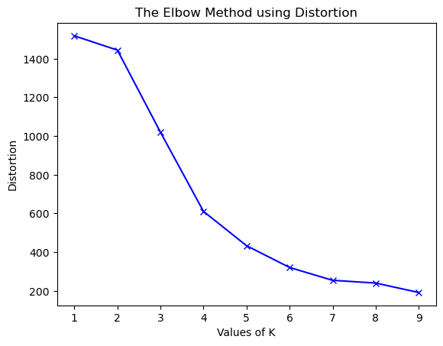
PCA and ELBOW Curve

Slide 14
Modeling
Logistic Model | Random Forest | Decision Tree | KNN Classifier
Accuracy: 0.7402597402597403 Precision: 0.7109375 Recall: 0.9680851063829787 F1-score: 0.8198198198198199 ROC-AUC score: 0.675709219858156 Confusion Matrix: [[23 37] [ 3 91]] | Accuracy: 0.7402597402597403 Precision: 0.7109375 Recall: 0.9680851063829787 F1-score: 0.8198198198198199 ROC-AUC score: 0.675709219858156 Confusion Matrix: [[23 37] [ 3 91]] | Accuracy: 0.6493506493506493 Precision: 0.696078431372549 Recall: 0.7553191489361702 F1-score: 0.7244897959183673 ROC-AUC score: 0.6193262411347518 Confusion Matrix: [[29 31] [23 71]] | Accuracy: 0.6363636363636364 Precision: 0.6439393939393939 Recall: 0.9042553191489362 F1-score: 0.7522123893805309 ROC-AUC score: 0.5604609929078015 Confusion Matrix: [[13 47] [ 9 85]]

Slide 15
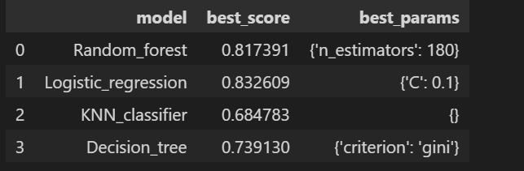
GRID SEARCH
Logistic Regression | Random Forest
Best parameters: {'C': 0.1, 'penalty': 'l1', 'solver': 'liblinear’} Best score: 0.832608695652174 Accuracy Logistic Model: 0.7402597402597403 Precision Logistic Model: 0.7109375 Recall Logistic Model: 0.9680851063829787 F1-score Logistic Model: 0.8198198198198199 | Best parameters: {'max_depth': 5, 'min_samples_leaf': 1, 'min_samples_split': 2, 'n_estimators': 50} Best score: 0.8304347826086957 Accuracy Random Forest Model: 0.7337662337662337 Precision Random Forest Model: 0.7086614173228346 Recall Random Forest Model: 0.9574468085106383 F1-score Random Forest Model: 0.8144796380090497

Slide 16
Deployment

Slide 17
Testing

Slide 18
Results

Slide 19
Challenges

